Slide 1
Input/Output Systems
  Some slides and/or pictures are adapted from
  Operating System Concepts, 9th edition, by Silberschatz, Galvin, Gagne, John Wiley & Sons, 2013
  Lecture notes by Dr. Prof. John Kubiatowicz (Berkeley)

Slide 2
The Requirements of I/O
What about I/O?
  Without I/O, computers are useless (disembodied brains?)
  But… thousands of devices, each slightly different
    How can we standardize the interfaces to these devices?
  Devices unreliable: media failures and transmission errors
    How can we make them reliable???
  Devices unpredictable and/or slow
    How can we manage them if we don’t know what they will do or how they will perform?
Some operational parameters:
  Byte/Block
    Some devices provide single byte at a time (e.g. keyboard)
    Others provide whole blocks (e.g. disks, networks, etc)
  Sequential/Random
    Some devices must be accessed sequentially (e.g. tape)
    Others can be accessed randomly (e.g. disk, cd, etc.)
  Polling/Interrupts
    Some devices require continual monitoring
    Others generate interrupts when they need service

Slide 3


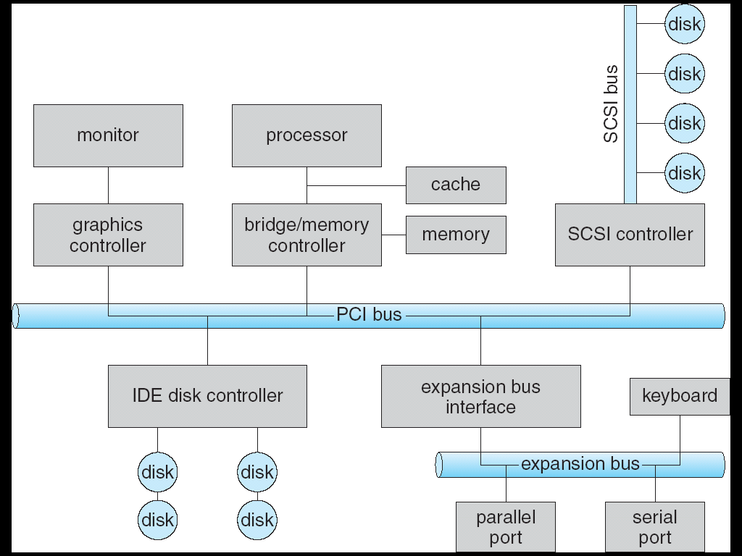

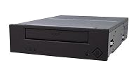
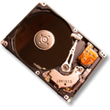


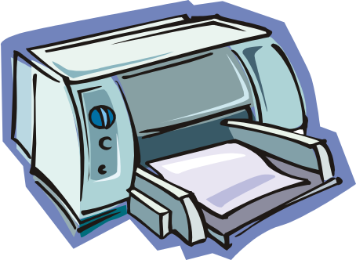
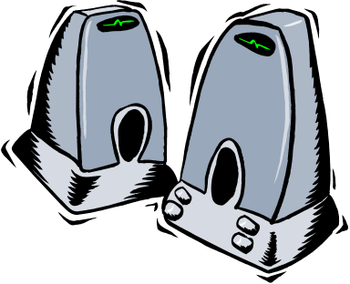

Modern I/O Systems

Slide 4
Peripheral Component Interconnect (PCI) Architecture
RAM
Memory
Bus
CPU
Host Bridge
PCI #0
ISA Bridge
PCI Bridge
PCI #1
ISA
Controller
PCI Slots
USB
Controller
SATA
Controller
Scanner
Legacy
Devices
Root Hub
Hard Disk
DVD ROM
Hub
Webcam
Mouse
Keyboard

Slide 5
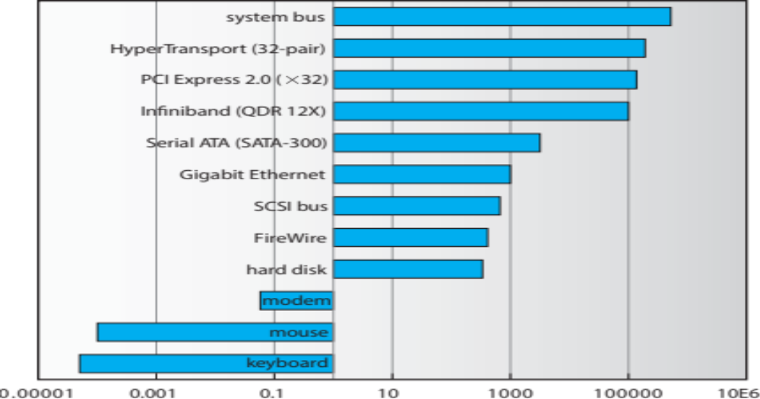
Sun Enterprise 6000 Device-Transfer Rates
Device Rates vary over 12 orders of magnitude
  System better be able to handle this wide range
  Better not have high overhead/byte for fast devices!
  Better not waste time waiting for slow devices

Slide 6
The Goal of the I/O Subsystem
Provide Uniform Interfaces, Despite Wide Range of Different Devices
  This code works on many different devices:
  FILE fd = fopen(“/dev/something”,”rw”);
  for (int i = 0; i < 10; i++) {
  fprintf(fd,”Count %d\n”,i);
  }
  close(fd);
  Why? Because code that controls devices (“device driver”) implements standard interface.
We will try to get a flavor for what is involved in actually controlling devices in rest of lecture.

Slide 7
Want Standard Interfaces to Devices
Block Devices: e.g. disk drives, DVD-ROM
  Access blocks of data
  Commands include open(), read(), write(), seek()
  Raw I/O or file-system access
  Memory-mapped file access possible
Byte Devices: e.g. keyboards, mice, serial ports, some USB devices
  Single characters at a time
  Commands include get(), put()
  Libraries layered on top allow line editing
Network Devices: e.g. Ethernet, Wireless, Bluetooth
  Different enough from block/character to have own interface
  Unix and Windows include socket interface
    Separates network protocol from network operation
    Includes select() functionality

Slide 8
How Does User Deal with Timing?
Blocking Interface: “Wait”
  When request data (e.g. read() system call), put process to sleep until data is ready
  When write data (e.g. write() system call), put process to sleep until device is ready for data
Non-blocking Interface: “Don’t Wait”
  Returns quickly from read or write request with count of bytes successfully transferred
  Read may return nothing, write may write nothing
Asynchronous Interface: “Tell Me Later”
  When request data, take pointer to user’s buffer, return immediately; later kernel fills buffer and notifies user
  When send data, take pointer to user’s buffer, return immediately; later kernel takes data and notifies user

Slide 9
How does the processor actually talk to the device?
Processor Memory Bus
Regular
Memory
CPU
Bus
Adaptor
Bus
Adaptor
Device
Controller
Address+
Data
Other Devices
or Buses
Bus
Interface
Hardware
Controller
Interrupt
Controller
Interrupt Request
read
Addressable
Memory
and/or
Queues
write
control
CPU interacts with a Controller
  Contains a set of registers that
  can be read and written
  May contain memory for request
  queues or bit-mapped images
Regardless of the complexity of the connections and buses, processor accesses registers in two ways:
  I/O instructions: in/out instructions
    Example from the Intel architecture: out 0x21,AL
  Memory mapped I/O: load/store instructions
    Registers/memory appear in physical address space
    I/O accomplished with load and store instructions
status
Registers
(port 0x20)
Memory Mapped
Region: 0x8f008020

Slide 10
Example: Memory-Mapped Display Controller
Memory-Mapped:
  Hardware maps control registers and display memory into physical address space
    Addresses set by hardware jumpers or programming at boot time
  Simply writing to display memory (also called the “frame buffer”) changes image on screen
    Addr: 0x8000F000—0x8000FFFF
  Writing graphics description to command-queue area
    Say enter a set of triangles that describe some scene
    Addr: 0x80010000—0x8001FFFF
  Writing to the command register may cause on-board graphics hardware to do something
    Say render the above scene
    Addr: 0x0007F004
0x80020000
Graphics
Command
Queue
0x80010000
Display
Memory
0x8000F000
0x0007F004
Command
0x0007F000
Status
Physical Address
Space

Slide 11
Transferring Data To/From Controller
Programmed I/O:
  Each byte transferred via processor in/out or load/store
  Pro: Simple hardware, easy to program
  Con: Consumes processor cycles proportional to data size
Direct Memory Access:
  Give controller access to memory bus
  Ask it to transfer data to/from memory directly

Slide 12
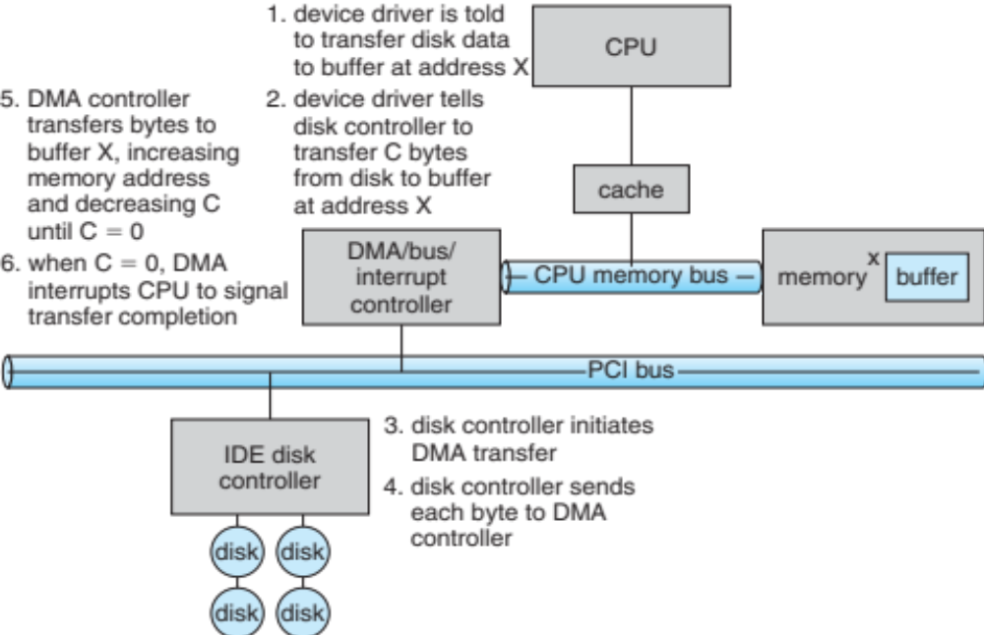
Six Step Process to Perform DMA Transfer

Slide 13

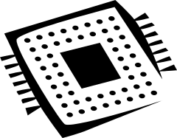

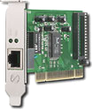
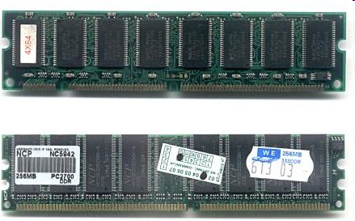
Kernel Device Structure
The System Call Interface
Process
Management
Memory
Management
Filesystems
Device
Control
Networking
Concurrency,
multitasking
Virtual
memory
Files and dirs:
the VFS
TTYs and
device access
Connectivity
Architecture
Dependent
Code
Memory
Manager
File System Types
Device
Control
Network
Subsystem
Block
Devices
IF drivers

Slide 14
Device Drivers
Device Driver: Device-specific code in the kernel that interacts directly with the device hardware
  Supports a standard, internal interface
  Same kernel I/O system can interact easily with different device drivers
  Special device-specific configuration supported with the ioctl() system call
Device Drivers typically divided into two pieces:
  Top half: accessed in call path from system calls
    implements a set of standard, cross-device calls like open(), close(), read(), write(), ioctl(), strategy()
    This is the kernel’s interface to the device driver
    Top half will start I/O to device, may put thread to sleep until finished
  Bottom half: run as interrupt routine
    Gets input or transfers next block of output
    May wake sleeping threads if I/O now complete

Slide 15
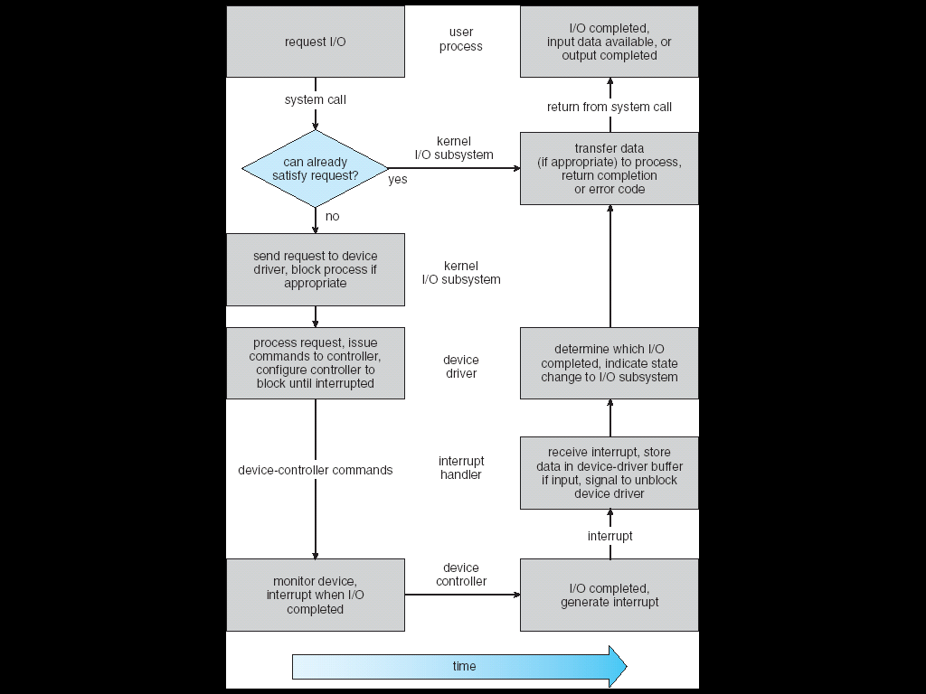
Life Cycle of An I/O Request
User
Program
Kernel I/O
Subsystem
Device Driver
Top Half
Device Driver
Bottom Half
Device
Hardware

Slide 16
I/O Device Notifying the OS
The OS needs to know when:
  The I/O device has completed an operation
  The I/O operation has encountered an error
I/O Interrupt:
  Device generates an interrupt whenever it needs service
  Handled in bottom half of device driver
    Often run on special kernel-level stack
  Pro: handles unpredictable events well
  Con: interrupts relatively high overhead
Polling:
  OS periodically checks a device-specific status register
    I/O device puts completion information in status register
    Could use timer to invoke lower half of drivers occasionally
  Pro: low overhead
  Con: may waste many cycles on polling if infrequent or unpredictable I/O operations
Actual devices combine both polling and interrupts
  For instance: High-bandwidth network device:
    Interrupt for first incoming packet
    Poll for following packets until hardware empty
Notes:
After the OS has issued a command to the I/O device either via a special I/O instruction or by writing to a location in the I/O address space, the OS needs to be notified when:
(a) The I/O device has completed the operation.
(b) Or when the I/O device has encountered an error.
This can be accomplished in two different ways: Polling and I/O interrupt.

Slide 17
Kernel I/O Subsystem
Scheduling
  Some I/O request ordering via per-device queue
  Some OSs try fairness
Buffering - store data in memory while transferring between devices
  To cope with device speed mismatch
  To cope with device transfer size mismatch
  To maintain “copy semantics”

Slide 18
Kernel I/O Subsystem
Caching - fast memory holding copy of data
  Always just a copy
  Key to performance
Spooling - hold output for a device
  If device can serve only one request at a time
  i.e., Printing
Device reservation - provides exclusive access to a device
  System calls for allocation and deallocation
  Watch out for deadlock

Slide 19
Error Handling
OS can recover from disk read, device unavailable, transient write failures
Most return an error number or code when I/O request fails
System error logs hold problem reports

Slide 20
Kernel Data Structures
Kernel keeps state info for I/O components, including open file tables, network connections, character device state
Many, many complex data structures to track buffers, memory allocation, “dirty” blocks
Some use object-oriented methods and message passing to implement I/O
  Windows uses message passing
    Message with I/O information passed from user mode into kernel
    Message modified as it flows through to device driver and back to process
    Pros / cons?

Slide 21
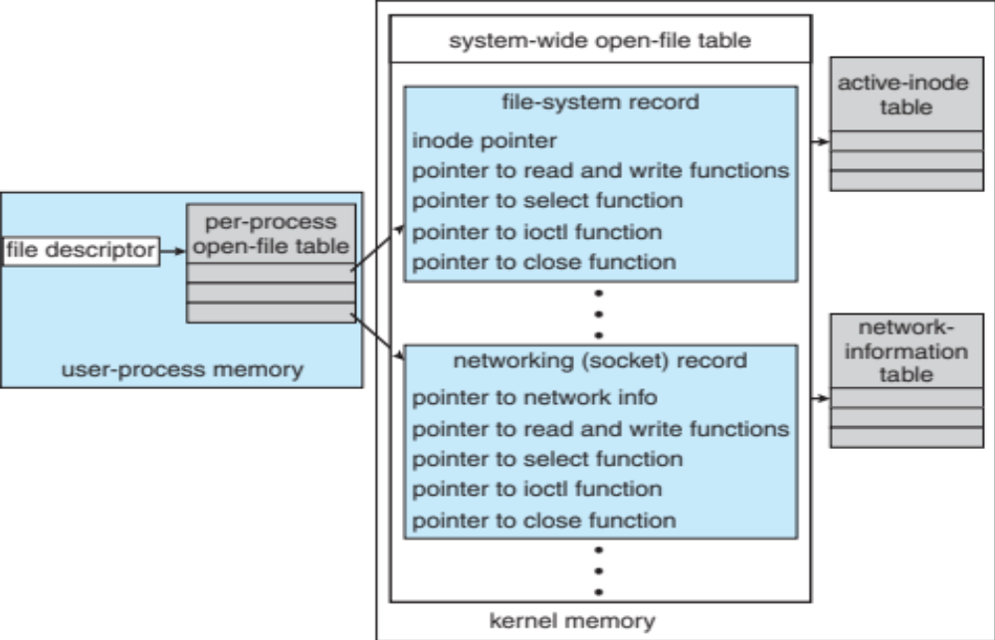
UNIX I/O Kernel Structure

Slide 22
What Determines Peak BandWidth for I/O ?
Bus Speed
  PCI-X: 1064 MB/s = 133 MHz x 64 bit (per lane)
  ULTRA WIDE SCSI: 40 MB/s
  Serial Attached SCSI & Serial ATA & IEEE 1394 (firewire): 1.6 Gb/s full duplex (200 MB/s)
  USB 3.0 – 5 Gb/s
  Thunderbolt 3 – 40 Gb/s
Device Transfer Bandwidth
  Rotational speed of disk
  Write / Read rate of NAND flash
  Signaling rate of network link
Whatever is the bottleneck in the path…

Slide 23
Storage Devices
Magnetic disks
  Storage that rarely becomes corrupted
  Large capacity at low cost
  Block level random access
  Slow performance for random access
  Better performance for sequential access
Flash memory
  Storage that rarely becomes corrupted
  Capacity at intermediate cost (5-20x disk)
  Block level random access
  Good performance for reads; worse for random writes
  Erasure requirement in large blocks
  Wear patterns issue

Slide 24

Disk Management

Slide 25
Properties of a Hard Magnetic Disk
Properties
  Head moves in to address circular track of information
  Independently addressable element: sector
    OS always transfers groups of sectors together—”blocks”
  Items addressable without moving head: cylinder
  A disk can be rewritten in place: it is possible to read/modify/write a block from the disk
Typical numbers (depending on the disk size):
  500 to more than 100,000 tracks per surface
  32 to 800 sectors per track
Zoned bit recording
  Constant bit density: more sectors on outer tracks
  Speed varies with track location
Notes:
Each surface on the platter are divided into tracks and each track is further divided into sectors. A sector is the smallest unit that can be read or written.
By simple geometry you know the outer track have more area and you would thing the outer track will have more sectors.
This, however, is not the case in traditional disk design where all tracks have the same number of sectors. Well, you will say, this is dumb but dumb is the reason they do it .
By keeping the number of sectors the same, the disk controller hardware and software can be dumb and does not have to know which track has how many sectors.
With more intelligent disk controller hardware and software, it is getting more popular to record more sectors on the outer tracks. This is referred to as constant bit density.

Slide 26
Performance Model
Read/write data is a three-stage process:
  Seek time: position the head/arm over the proper track (into proper cylinder)
  Rotational latency: wait for the desired sector
  to rotate under the read/write head
  Transfer time: transfer a block of bits (sector)
  under the read-write head
Highest Bandwidth:
  Transfer large group of blocks sequentially from one track
Notes:
To read write information into a sector, a movable arm containing a read/write head is located over each surface.
The term cylinder is used to refer to all the tracks under the read/write head at a given point on all surfaces.
To access data, the operating system must direct the disk through a 3-stage process.
(a) The first step is to position the arm over the proper track. This is the seek operation and
the time to complete this operation is called the seek time.
(b) Once the head has reached the correct track, we must wait for the desired sector to
rotate under the read/write head. This is referred to as the rotational latency.
(c) Finally, once the desired sector is under the read/write head, the data transfer can begin.
The average seek time as reported by the manufacturer is in the range of 12 ms to 20ms and is calculated as the sum of the time for all possible seeks divided by the number of possible seeks.
This number is usually on the pessimistic side because due to locality of disk reference, the actual average seek time may only be 25 to 33% of the number published.

Slide 27
Disk Performance Example
Assumptions:
  Ignoring queuing and controller times for now
  Avg seek time of 5ms,
  7200RPM ⇒ Time for rotation: 60000 (ms/minute) / 7200(rev/min) ~= 8ms
  Transfer rate of 4MByte/s, sector size of 1 Kbyte ⇒
  1024 bytes/4×10⁶ (bytes/s) = 256 × 10⁻⁶ sec ≅ .26 ms
Read sector from random place on disk:
  Seek (5ms) + Rot. Delay (4ms) + Transfer (0.26ms)
  Approx 10ms to fetch/put data: 100 KByte/sec
Read sector from random place in same cylinder:
  Rot. Delay (4ms) + Transfer (0.26ms)
  Approx 5ms to fetch/put data: 200 KByte/sec
Read next sector on same track:
  Transfer (0.26ms): 4 MByte/sec
Key to using disk effectively (especially for file systems) is to minimize seek and rotational delays

Slide 28
Disk Scheduling
The operating system is responsible for using hardware efficiently — for the disk drives, this means having a fast access time and disk bandwidth
Minimize seek time
Seek time ≈ seek distance
Disk bandwidth is the total number of bytes transferred, divided by the total time between the first request for service and the completion of the last transfer

Slide 29
Disk Scheduling (Cont.)
There are many sources of disk I/O request
  OS
  System processes
  Users processes
I/O request includes input or output mode, disk address, memory address, number of sectors to transfer
OS maintains queue of requests, per disk or device
Idle disk can immediately work on I/O request, busy disk means work must queue
  Optimization algorithms only make sense when a queue exists

Slide 30
Disk Scheduling (Cont.)
Note that drive controllers have small buffers and can manage a queue of I/O requests (of varying “depth”)
Several algorithms exist to schedule the servicing of disk I/O requests
The analysis is true for one or many platters
We illustrate scheduling algorithms with a request queue (0-199)
98, 183, 37, 122, 14, 124, 65, 67
Head pointer 53

Slide 31

FCFS
Illustration shows total head movement of 640 cylinders

Slide 32

SSTF
Shortest Seek Time First selects the request with the minimum seek time from the current head position
SSTF scheduling is a form of SJF scheduling; may cause starvation of some requests
Illustration shows total head movement of 236 cylinders

Slide 33
SCAN
The disk arm starts at one end of the disk, and moves toward the other end, servicing requests until it gets to the other end of the disk, where the head movement is reversed and servicing continues.
SCAN algorithm Sometimes called the elevator algorithm
Illustration shows total head movement of 208 cylinders
But note that if requests are uniformly dense, largest density at other end of disk and those wait the longest

Slide 34

SCAN (Cont.)

Slide 35
C-SCAN
Provides a more uniform wait time than SCAN
The head moves from one end of the disk to the other, servicing requests as it goes
  When it reaches the other end, however, it immediately returns to the beginning of the disk, without servicing any requests on the return trip
Treats the cylinders as a circular list that wraps around from the last cylinder to the first one
Total number of cylinders?

Slide 36

C-SCAN (Cont.)

Slide 37
C-LOOK
LOOK a version of SCAN, C-LOOK a version of C-SCAN
Arm only goes as far as the last request in each direction, then reverses direction immediately, without first going all the way to the end of the disk
Total number of cylinders?

Slide 38

C-LOOK (Cont.)

Slide 39
Selecting a Disk-Scheduling Algorithm
SSTF is common and has a natural appeal
SCAN and C-SCAN perform better for systems that place a heavy load on the disk
  Less starvation
Either SSTF or LOOK is a reasonable choice for the default algorithm
What about rotational latency?
  Difficult for OS to calculate
How does disk-based queueing effect OS queue ordering efforts?

Slide 40
Disk Management
Low-level formatting, or physical formatting — Dividing a disk into sectors that the disk controller can read and write
  Each sector can hold header information, plus data, plus error correction code (ECC)
  Usually 512 bytes of data but can be selectable
To use a disk to hold files, the operating system still needs to record its own data structures on the disk
  Partition the disk into one or more groups of cylinders, each treated as a logical disk
  Logical formatting or “making a file system”

Slide 41
Disk Management (Cont.)
Raw disk access for apps that want to do their own block management, keep OS out of the way (databases for example)
Boot block initializes system
  The bootstrap is stored in ROM
  Bootstrap loader program stored in boot blocks of boot partition
Methods such as sector sparing used to handle bad blocks

Slide 42

Booting from a Disk in Windows

Slide 43
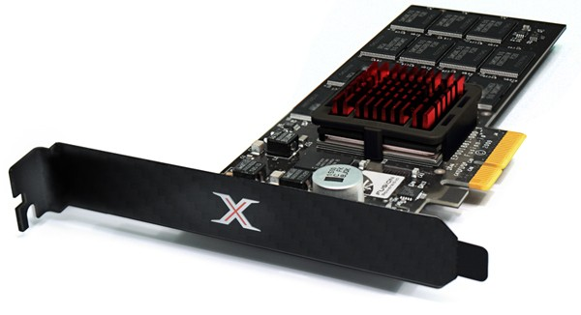
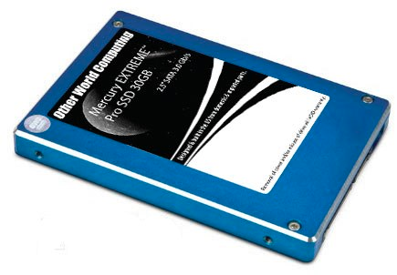
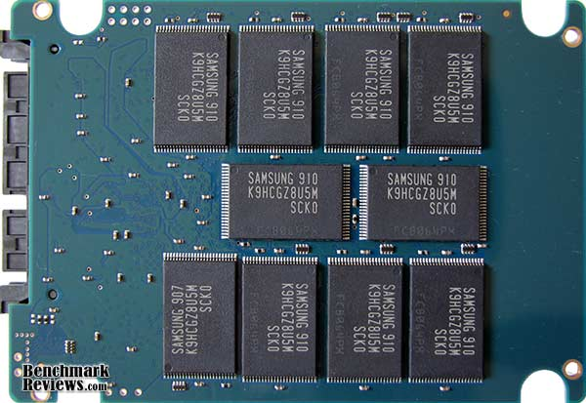
Solid State Disks (SSDs)
1995 – Replace rotating magnetic media with non-volatile memory (battery backed DRAM)
2009 – Use NAND Multi-Level Cell (2 or 3-bit/cell) flash memory
  Sector (4 KB page) addressable, but stores 4-64 “pages” per memory block
  Trapped electrons distinguish between 1 and 0
No moving parts (no rotate/seek motors)
  Eliminates seek and rotational delay
  Very low power and lightweight
  Limited “write cycles”
Rapid advances in capacity and cost ever since!

Slide 44
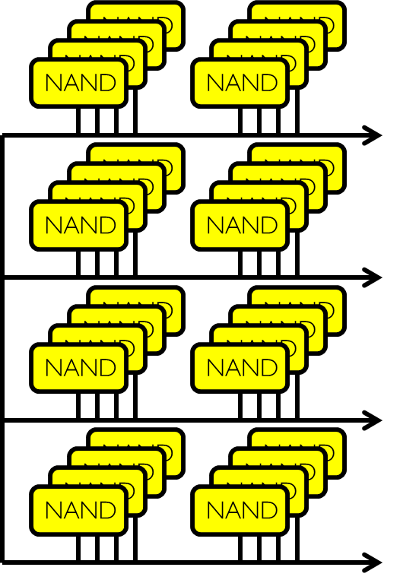
SSD Architecture – Reads
Host
Buffer
Manager
(software
Queue)
Flash
Memory
Controller
SATA
DRAM
  Read 4 KB Page: ~25 usec
  No seek or rotational latency
  Transfer time: transfer a 4KB page
    SATA: 300-600MB/s => ~4 x10³ b / 400 x 10⁶ bps => 10 us
  Latency = Queuing Time + Controller time + Xfer Time
  Highest Bandwidth: Sequential OR Random reads

Slide 45
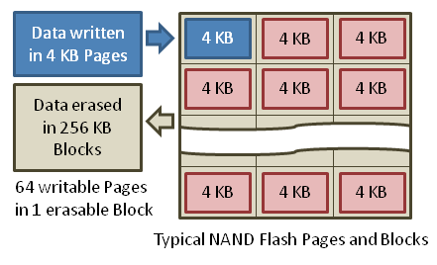
SSD Architecture – Writes
  Writing data is complex! (~200μs – 1.7ms )
  Can only write empty pages in a block
  Erasing a block takes ~1.5ms
  Controller maintains pool of empty blocks by coalescing used pages (read, erase, write), also reserves some % of capacity
Rule of thumb: writes 10x reads, erasure 10x writes
https://en.wikipedia.org/wiki/Solid-state_drive

Slide 46
SSD Summary
Pros (vs. hard disk drives):
  Low latency, high throughput (eliminate seek/rotational delay)
  No moving parts:
    Very light weight, low power, silent, very shock insensitive
  Read at memory speeds (limited by controller and I/O bus)
Cons
  Small storage (0.1-0.5x disk), expensive (3-20x disk)
    Hybrid alternative: combine small SSD with large HDD

Slide 47
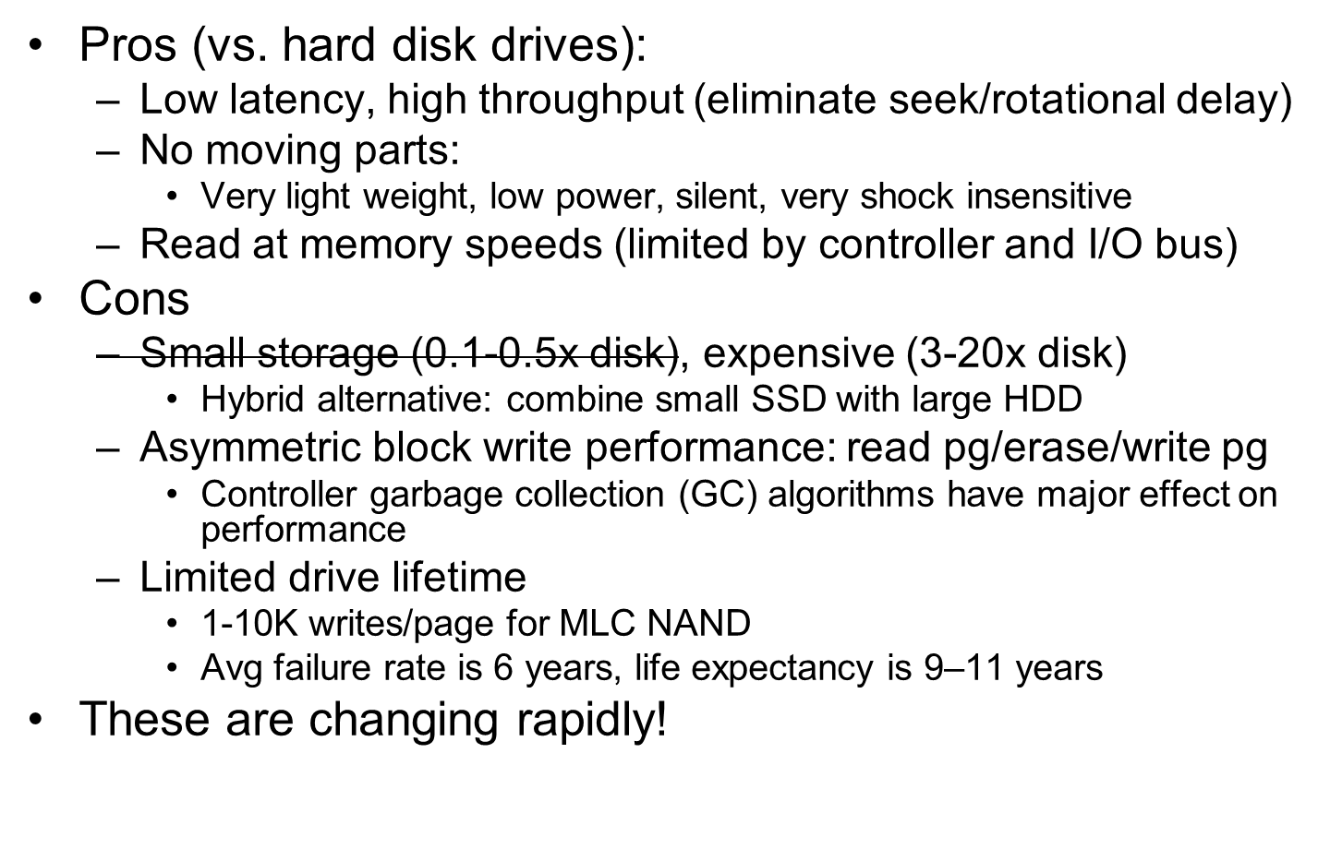
SSD Summary
No longer true!

Slide 48
I/O Performance
300
Response
Time (ms)
Controller
User
Thread
I/O
device
200
Queue
[OS Paths]
100
Response Time = Queue + I/O device service time
0
Performance of I/O subsystem
  Metrics: Response Time, Throughput
  Effective BW per op = transfer size / response time
    EffBW(n) = n / (S + n/B) = B / (1 + SB/n )
0%
100%
Throughput (Utilization)
(% total BW)
# of ops
time per op
Fixed overhead

Slide 49
I/O Performance
300
Response
Time (ms)
Controller
User
Thread
I/O
device
200
Queue
[OS Paths]
100
Response Time = Queue + I/O device service time
0
Performance of I/O subsystem
  Metrics: Response Time, Throughput
  Effective BW per op = transfer size / response time
    EffBW(n) = n / (S + n/B) = B / (1 + SB/n )
  Contributing factors to latency:
    Software paths (can be loosely modeled by a queue)
    Hardware controller
    I/O device service time
Queuing behavior:
  Can lead to big increases of latency as utilization increases
  Solutions?
0%
100%
Throughput (Utilization)
(% total BW)

